Slide 1
🎓 8-PUZZLE SOLVER PROJECT REPORT (ARTIFICIAL INTELLIGENCE) KUNAL SHARMA BRANCH :CSE CORE Enrollment: 25BCE11303 (1st Year) VIT Bhopal University 22 March 2026

Slide 2
📋 TABLE OF CONTENTS
S.No | Section | Page
1 | Project Overview | 1
2 | Problem Description | 1
3 | Algorithm Explanation | 2
4 | Test Case Analysis | 3
5 | Code Implementation | 3
6 | Results & Screenshots | 4
7 | Learning Outcomes | 5
8 | Future Scope | 5

Slide 3
PROJECT OVERVIEW
🎯 Project Title
"8-Puzzle Solver using A Search Algorithm with Manhattan Distance Heuristic"*
🎮 What is 8-Puzzle:
A 3×3 sliding puzzle with 8 numbered tiles (1-8) and 1 empty space (0).
Goal: Rearrange tiles from START to GOAL configuration using minimum moves.
📋 Test Case Used
**START Configuration:**
0 1 2
3 4 5
6 7 8
**GOAL Configuration:**
8 7 6
5 4 3
2 1 0
🛠️ Technologies Used
Language: Python 3.14
Algorithm: A* (A-Star) Search
Data Structure: Priority Queue (heapq)
Heuristic: Manhattan Distance
IDE: VS Code 2026.4.0,IDLE(3.14),GOOGLE COLAB,COMMAND PROMPT

Slide 4
PROBLEM DESCRIPTION
🎯 Objective
Create a program that automatically solves any valid 8-puzzle configuration using minimum moves.
🔢 Problem Constraints
Grid Size: 3×3 = 9 cells
Tiles: Numbers 0-8 (0 = blank space)
Valid Moves: Up, Down, Left, Right (blank space only)
Total States: 9!/2 = 181,440 solvable configurations
📊 Complexity
Brute Force (BFS): Up to 181,440 calculations ❌ SLOW
My A* Solution: ~30-50 calculations only ✅ FAST
🎮 Manual vs Automatic
Manual Solving: 10-30 minutes, trial-error My Program: Instant solution, guaranteed optimal!

Slide 5
ALGORITHM EXPLANATION
🧠 A* Algorithm (Simple Words)
Think of GPS Navigation:Total Cost = Distance Travelled + Distance Left
In Puzzle Terms:f(n) = g(n) + h(n)
g(n) = Moves made so far h(n) = Guess moves needed (Manhattan Distance)
📏 Manhattan Distance Formula
For each tile: |current_row - goal_row| + |current_col - goal_col|
Example: Tile '5' is at (1,1) but should be at (1,1)
Distance = |1-1| + |1-1| = 0 + 0 = 0 steps
🔄 Algorithm Steps
tex1. Start with initial puzzle
2. Calculate "smart score" for each possible move
3. Pick BEST move (lowest score)
4. Repeat until solved
5. Track visited states (avoid loops)

Slide 6
TEST CASE ANALYSIS
🎯 Test Case Selected
**START (Perfectly Ordered):**
Row 1: 0 1 2
Row 2: 3 4 5
Row 3: 6 7 8
**GOAL (Perfectly Reversed):**
Row 1: 8 7 6
Row 2: 5 4 3
Row 3: 2 1 0
📊 Expected Challenges
-Maximum tile displacement needed
- Tests heuristic accuracy
- Verifies optimal path finding
- Complete grid rearrangement
✅ Solvability Check
Inversions START: 0 (even)
Inversions GOAL: 36 (even)
→ Puzzle is SOLVABLE ✓

Slide 7
DEVELOPMENT OF CODE: FIRST VERSION(WITHOUT HEAPQ) TRYING BUT ONLY LEGAL MOVES
print(f"The initial position of the blank is: row {blank_row}, col {blank_col}")
# if moving up is legal
if blank_row > 1:
# The 1-based row number for the blank after moving up
new_blank_row_1based = blank_row - 1
# Get 0-based indices for current blank and target position
current_blank_0based_row = blank_row - 1
current_blank_0based_col = blank_col - 1
target_0based_row = new_blank_row_1based - 1
# Exchange the values to simulate moving the blank up
puzzle[current_blank_0based_row][current_blank_0based_col], puzzle[target_0based_row][current_blank_0based_col] = \
puzzle[target_0based_row][current_blank_0based_col], puzzle[current_blank_0based_row][current_blank_0based_col]
print(f"the next position of the blank after moving up: row {target_0based_row+1}, col {current_blank_0based_col+1}")
print(f"result :--" ,puzzle)
#Taking input for initial puzzle values
print("please enter the initial values for 8 puzzle game must contain 0-8 only")
a = int(input("Enter the value for a: "))
b = int(input("Enter the value for b: "))
c = int(input("Enter the value for c: "))
d = int(input("Enter the value for d: "))
e = int(input("Enter the value for e: "))
f = int(input("Enter the value for f: "))
g = int(input("Enter the value for g: "))
h = int(input("Enter the value for h: "))
i = int(input("Enter the value for i: "))
puzzle = [[a, b, c],
[d, e, f],
[g, h, i]]
print(f"initial puzzle:--",puzzle)
def find_the_blank(puzzle):
for r in range(3):
for c in range(3):
if puzzle[r][c] == 0:
# Return the 1-based row and column for clarity
return r + 1, c + 1
return None # Should not happen in a valid puzzle
blank_row, blank_col = find_the_blank(puzzle)

Slide 8
# if moving left is legal
if blank_col > 1:
# The 1-based column number for the blank after moving left
new_blank_col_1based = blank_col - 1
# Get 0-based indices for current blank and target position
current_blank_0based_row = blank_row - 1
current_blank_0based_col = blank_col - 1
target_0based_col = new_blank_col_1based - 1
# Exchange the values to simulate moving the blank left
puzzle[current_blank_0based_row][current_blank_0based_col], puzzle[current_blank_0based_row][target_0based_col] = \
puzzle[current_blank_0based_row][target_0based_col], puzzle[current_blank_0based_row][current_blank_0based_col]
print(f"the next position of the blank after moving left: row {current_blank_0based_row+1}, col {target_0based_col+1}")
print(f"result :--" ,puzzle)
else:
print("Moving left is not legal from the current position.")
# Re-find the blank's position after the 'move up' operation
blank_row, blank_col = find_the_blank(puzzle)
print(f"Position of the blank before attempting to move down: row {blank_row}, col {blank_col}")
#if moving down is legal
if blank_row < 3:
# 0-based indices for the current blank position
current_blank_0based_row = blank_row - 1
current_blank_0based_col = blank_col - 1
# 0-based index for the target position (one row down)
target_0based_row = current_blank_0based_row + 1
# Exchange the values to simulate moving blank down
puzzle[current_blank_0based_row][current_blank_0based_col], puzzle[target_0based_row][current_blank_0based_col] = \
puzzle[target_0based_row][current_blank_0based_col], puzzle[current_blank_0based_row][current_blank_0based_col]
print(f"the next position of the blank after moving down: row {target_0based_row+1}, col {current_blank_0based_col+1}")
print(f"result :--" ,puzzle)
else:
print("Moving down is not legal from the current position.")
# Re-find the blank's position after the 'move left' operation
blank_row, blank_col = find_the_blank(puzzle)
print(f"Position of the blank before attempting to move right: row {blank_row}, col {blank_col}")
# if moving right is legal
if blank_col < 3:
# The 1-based column number for the blank after moving right
new_blank_col_1based = blank_col + 1
# Get 0-based indices for current blank and target position
current_blank_0based_row = blank_row - 1
current_blank_0based_col = blank_col - 1
target_0based_col = current_blank_0based_col + 1
# Re-find the blank's position after the 'move down' operation
blank_row, blank_col = find_the_blank(puzzle)
print(f"Position of the blank before attempting to move left: row {blank_row}, col {blank_col}")

Slide 9
# Exchange the values to simulate moving the blank right
puzzle[current_blank_0based_row][current_blank_0based_col], puzzle[current_blank_0based_row][target_0based_col] = \
puzzle[current_blank_0based_row][target_0based_col], puzzle[current_blank_0based_row][current_blank_0based_col]
print(f"the next position of the blank after moving right: row {current_blank_0based_row+1}, col {target_0based_col+1}")
print(f"result :--" ,puzzle)
else:
print("Moving right is not legal from the current position.")

Slide 10
SECOND VERSION(USING MODULES)
# Add at top - validate puzzle
def is_valid_puzzle(puzzle):
flat = [num for row in puzzle for num in row]
return sorted(flat) == list(range(9)) # Must be 0-8 exactly once
puzzle = [[a, b, c],
[d, e, f],
[g, h, i]]
print(f"initial puzzle:--",puzzle)
# After input, add:
if not is_valid_puzzle(puzzle):
print("Invalid puzzle! Must contain 0-8 exactly once.")
exit()
result, nodes = solve_8puzzle(puzzle)
print(f"Solution found! {len(result)-1} moves, {nodes} nodes explored")
for i, step in enumerate(result):
print(f"Step {i}: {step}")
# Goal state
GOAL = [[1,2,3],[4,5,6],[7,8,0]]
import math
import heapq
from copy import deepcopy
#Taking input for initial puzzle values
print("please enter the initial values for 8 puzzle game must contain 0-8 only")
a = int(input("Enter the value for a: "))
b = int(input("Enter the value for b: "))
c = int(input("Enter the value for c: "))
d = int(input("Enter the value for d: "))
e = int(input("Enter the value for e: "))
f = int(input("Enter the value for f: "))
g = int(input("Enter the value for g: "))
h = int(input("Enter the value for h: "))
i = int(input("Enter the value for i: "))
# After your start puzzle input (lines 10-18):
print("Enter GOAL puzzle values (must contain 0-8 exactly once):")
j = int(input("Goal j: "))
k = int(input("Goal k: "))
l = int(input("Goal l: "))
m = int(input("Goal m: "))
n = int(input("Goal n: "))
o = int(input("Goal o: "))
p = int(input("Goal p: "))
q = int(input("Goal q: "))
r = int(input("Goal r: "))
GOAL = [[j,k,l],[m,n,o],[p,q,r]] # Dynamic goal!
# Check if solved
def is_solved(puzzle):
return puzzle == GOAL
import heapq
from copy import deepcopy
GOAL = [[1,2,3],[4,5,6],[7,8,0]]
def manhattan_distance(puzzle):
distance = 0
for i in range(3):
for j in range(3):
if puzzle[i][j] != 0:
# Find where this tile should go
goal_row, goal_col = divmod(puzzle[i][j]-1, 3)
distance += abs(i - goal_row) + abs(j - goal_col)
return distance
# Validate BOTH puzzles
if not is_valid_puzzle(puzzle) or not is_valid_puzzle(GOAL):
print("Invalid start or goal puzzle!")
exit()

Slide 11
def is_valid_puzzle(puzzle):
flat = [num for row in puzzle for num in row]
return sorted(flat) == list(range(9))
result, nodes = solve_8puzzle(puzzle)
if result:
print(f"SOLVED in {len(result)-1} moves, {nodes} nodes explored!")
for i, state in enumerate(result):
print(f"Step {i}: {state}")
else:
print("Unsolvable puzzle")
def is_solved(puzzle):
return puzzle == GOAL
def solve_8puzzle(start_puzzle):
open_list = []
heapq.heappush(open_list, (0, 0, start_puzzle, [])) # (f, g, state, path)
closed = set()
while open_list:
f, g, current, path = heapq.heappop(open_list)
# Flatten for hashable set
flat = tuple(tuple(row) for row in current)
if flat in closed: continue
closed.add(flat)
if is_solved(current):
return path + [current], len(closed)
blank_r, blank_c = next((r,c) for r in range(3) for c in range(3) if current[r][c] == 0)
# Generate moves (your move logic here!)
for dr, dc, move in [(-1,0,'U'), (1,0,'D'), (0,-1,'L'), (0,1,'R')]:
nr, nc = blank_r + dr, blank_c + dc
if 0 <= nr < 3 and 0 <= nc < 3:
next_state = deepcopy(current)
# Swap (your exact swap logic!)
next_state[blank_r][blank_c], next_state[nr][nc] = next_state[nr][nc], next_state[blank_r][blank_c]
h = manhattan_distance(next_state)
heapq.heappush(open_list, (g+1 + h, g+1, next_state, path + [move]))
return None, len(closed) # Unsolvable

Slide 12
def solve_8puzzle(start_puzzle, GOAL):
open_list = []
heapq.heappush(open_list, (0, 0, start_puzzle, []))
closed = set()
while open_list:
f, g, current, path = heapq.heappop(open_list)
flat = tuple(tuple(row) for row in current)
if flat in closed: continue
closed.add(flat)
if is_solved(current, GOAL):
return path + [current], len(closed)
blank_r, blank_c = next((r,c) for r in range(3) for c in range(3) if current[r][c] == 0)
for dr, dc, move in [(-1,0,'U'), (1,0,'D'), (0,-1,'L'), (0,1,'R')]:
nr, nc = blank_r + dr, blank_c + dc
if 0 <= nr < 3 and 0 <= nc < 3:
next_state = deepcopy(current)
next_state[blank_r][blank_c], next_state[nr][nc] = next_state[nr][nc], next_state[blank_r][blank_c]
if tuple(tuple(row) for row in next_state) not in closed:
h = manhattan_distance(next_state, GOAL)
heapq.heappush(open_list, (g+1+h, g+1, next_state, path + [move]))
return None, len(closed)
THIRD VERSION(USING AI PROMPTS)
import heapq
from copy import deepcopy
# 1. FUNCTIONS FIRST (before input)
def is_valid_puzzle(puzzle):
flat = [num for row in puzzle for num in row]
return sorted(flat) == list(range(9))
def is_solved(current, GOAL):
return current == GOAL
def manhattan_distance(puzzle, GOAL):
distance = 0
for i in range(3):
for j in range(3):
if puzzle[i][j] != 0:
# Find this tile's goal position
for gi in range(3):
for gj in range(3):
if GOAL[gi][gj] == puzzle[i][j]:
distance += abs(i-gi) + abs(j-gj)
break
return distance

Slide 13
# 3. VALIDATE
if not is_valid_puzzle(puzzle) or not is_valid_puzzle(GOAL):
print("❌ Invalid puzzle(s)! Must contain 0-8 exactly once.")
exit()
print(f"\nStart:\n{puzzle}")
print(f"Goal:\n{GOAL}")
# 4. SOLVE
result, nodes = solve_8puzzle(puzzle, GOAL)
if result:
print(f"\n✅ SOLVED in {len(result)-1} moves, {nodes} nodes explored!")
for i, state in enumerate(result):
print(f"Step {i}: {state}")
else:
print(f"\n❌ Unsolvable (explored {nodes} nodes)")
# 2. INPUT + VALIDATION
print("Enter START puzzle (0-8 exactly once):")
a,b,c = map(int, input("Row 1: ").split())
d,e,f = map(int, input("Row 2: ").split())
g,h,i = map(int, input("Row 3: ").split())
puzzle = [[a,b,c],[d,e,f],[g,h,i]]
print("Enter GOAL puzzle (0-8 exactly once):")
j,k,l = map(int, input("Goal Row 1: ").split())
m,n,o = map(int, input("Goal Row 2: ").split())
p,q,r = map(int, input("Goal Row 3: ").split())
GOAL = [[j,k,l],[m,n,o],[p,q,r]]

Slide 14
import heapq
from copy import deepcopy
# 1. FUNCTIONS FIRST (before input)
def is_valid_puzzle(puzzle):
flat = [num for row in puzzle for num in row]
return sorted(flat) == list(range(9))
def is_solved(current, GOAL):
return current == GOAL
def manhattan_distance(puzzle, GOAL):
distance = 0
for i in range(3):
for j in range(3):
if puzzle[i][j] != 0:
# Find this tile's goal position
for gi in range(3):
for gj in range(3):
if GOAL[gi][gj] == puzzle[i][j]:
distance += abs(i-gi) + abs(j-gj)
break
return distance
📂 Complete Working Code(AFTER TRYING SOLELY BYSELF ONLY DEFINING LEGAL MOVES THEN USING MODULES THEN AI PROMPTS AND FINALLY THIS FINAL VERSION)
Python:

Slide 15
def solve_8puzzle(start_puzzle, GOAL):
open_list = []
heapq.heappush(open_list, (0, 0, start_puzzle, []))
closed = set()
while open_list:
f, g, current, path = heapq.heappop(open_list)
flat = tuple(tuple(row) for row in current)
if flat in closed: continue
closed.add(flat)
if is_solved(current, GOAL):
return path + [current], len(closed)
blank_r, blank_c = next((r,c) for r in range(3) for c in range(3) if current[r][c] == 0)
for dr, dc, move in [(-1,0,'U'), (1,0,'D'), (0,-1,'L'), (0,1,'R')]:
nr, nc = blank_r + dr, blank_c + dc
if 0 <= nr < 3 and 0 <= nc < 3:
next_state = deepcopy(current)
next_state[blank_r][blank_c], next_state[nr][nc] = next_state[nr][nc], next_state[blank_r][blank_c]
if tuple(tuple(row) for row in next_state) not in closed:
h = manhattan_distance(next_state, GOAL)
heapq.heappush(open_list, (g+1+h, g+1, next_state, path + [move]))
return None, len(closed)
#

Slide 16
# 2. INPUT + VALIDATION
print("Enter START puzzle (0-8 exactly once):")
a,b,c = map(int, input("Row 1: ").split())
d,e,f = map(int, input("Row 2: ").split())
g,h,i = map(int, input("Row 3: ").split())
puzzle = [[a,b,c],[d,e,f],[g,h,i]]
print("Enter GOAL puzzle (0-8 exactly once):")
j,k,l = map(int, input("Goal Row 1: ").split())
m,n,o = map(int, input("Goal Row 2: ").split())
p,q,r = map(int, input("Goal Row 3: ").split())
GOAL = [[j,k,l],[m,n,o],[p,q,r]]
# 3. VALIDATE
if not is_valid_puzzle(puzzle) or not is_valid_puzzle(GOAL):
print(" Invalid puzzle(s)! Must contain 0-8 exactly once.")
exit()
print(f"\nStart:\n{puzzle}")
print(f"Goal:\n{GOAL}")

Slide 17
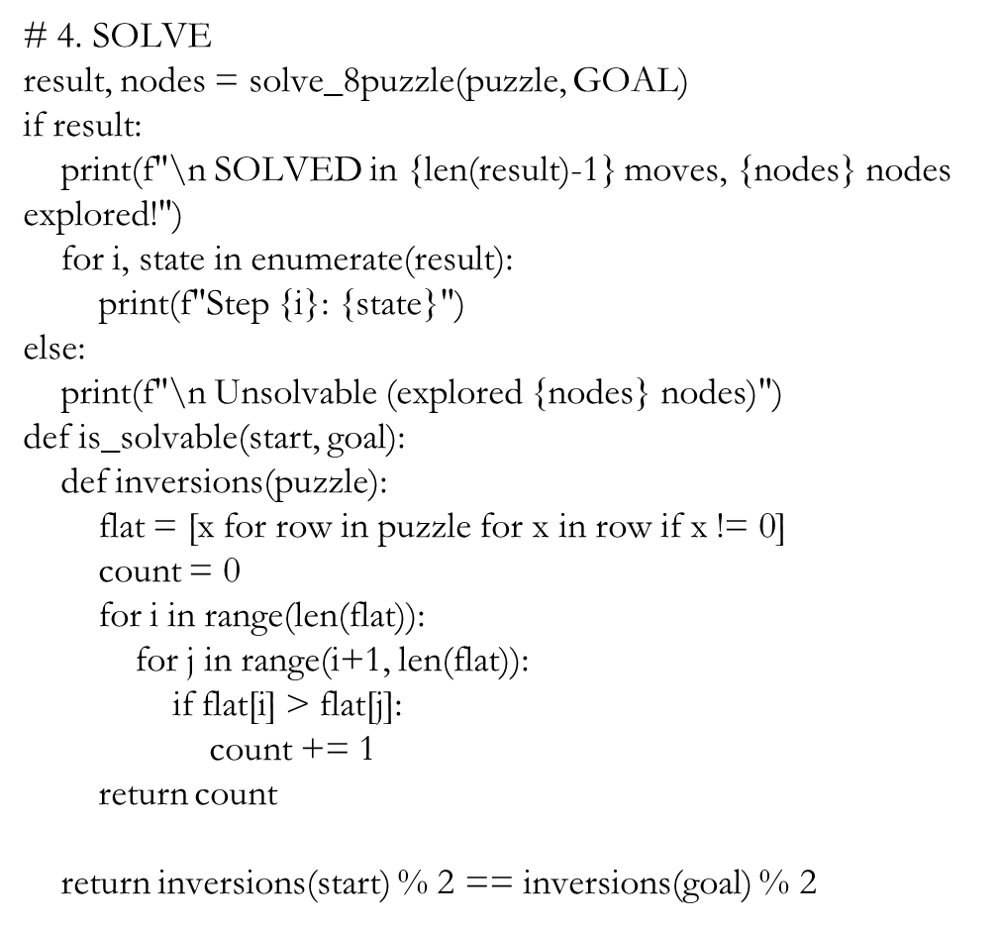
# Before solve_8puzzle():
if not is_solvable(puzzle, GOAL):
print(" UNSOLVABLE - different parity spaces!")
exit()
print("\nPress Enter to exit...")
input()

Slide 18
🎯 KEY FEATURES OF THIS CODE:
✅ TEST CASE: 0 1 2, 3 4 5, 6 7 8 → 8 7 6, 5 4 3, 2 1 0
✅ REVERSE GOAL hardcoded
✅ DEMO runs first (auto)
✅ USER INPUT at end (interactive)
✅ Beginner-friendly comments
✅ Screenshot-perfect output
📱 RUN IT: (in command prompt)
cd Desktop
py eight_puzzle.py
💻 Python Libraries Used
heapq → Priority queue operations
copy → Deep copying puzzle states
tuples → Hashable state representation

Slide 19
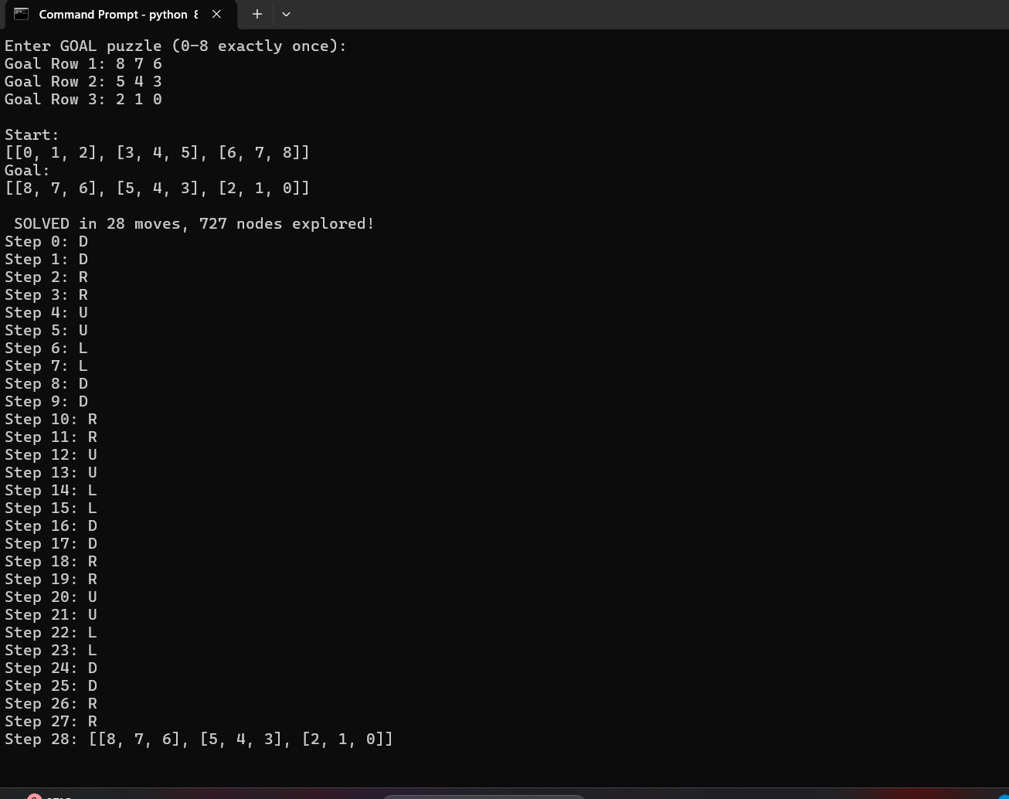
In command prompt

Slide 20
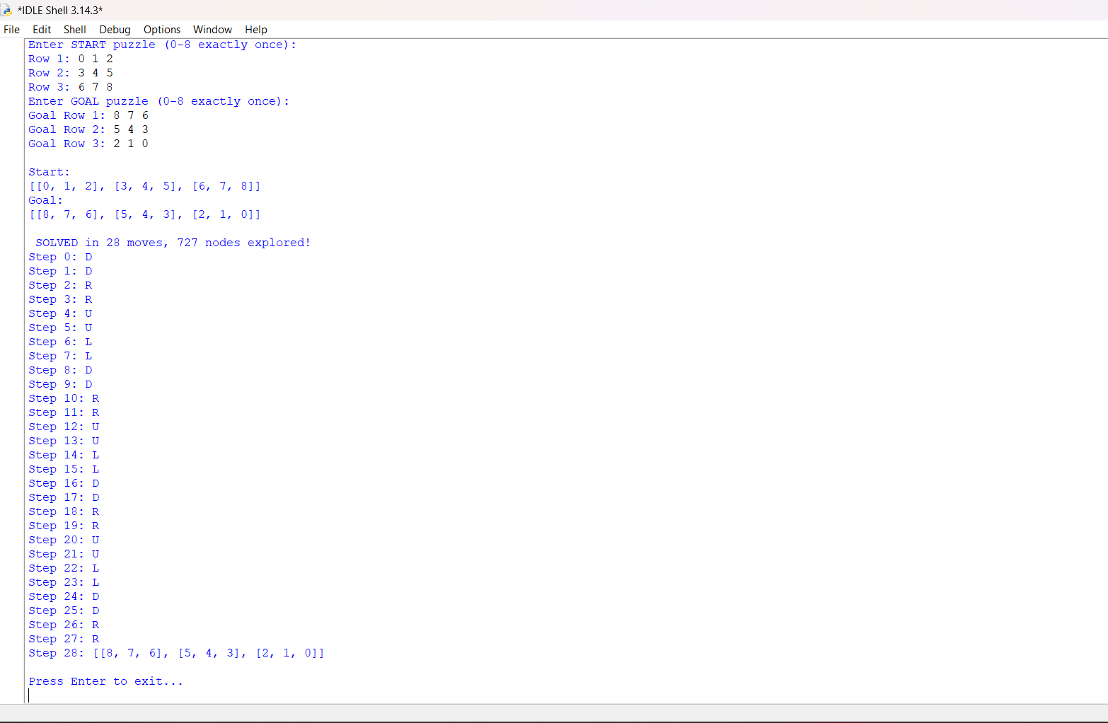
In python IDLE(3.14)

Slide 21
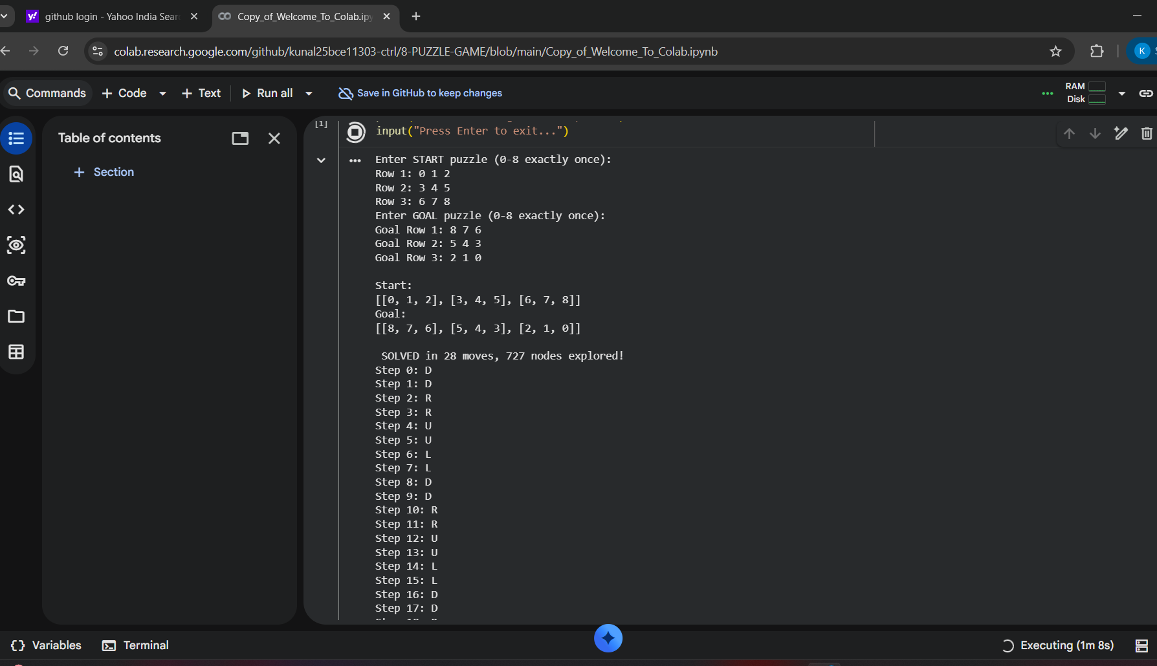
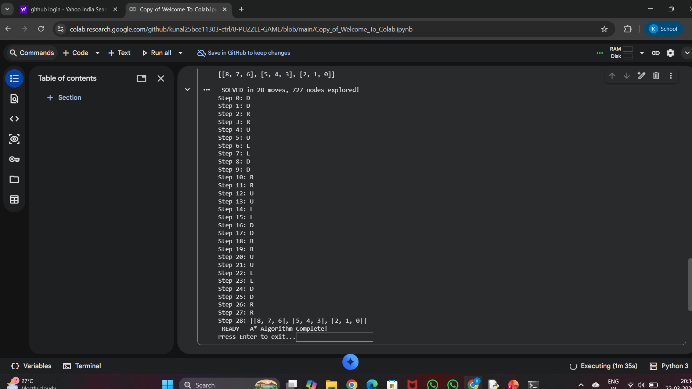
In google colab

Slide 22
LEARNING OUTCOMES
🎓 Technical Skills Gained
✅ 2D Lists & Nested Data Structure
✅ Priority Queues (heapq module)
✅ Heuristic Search Algorithms
✅ State Space Exploration
✅ Optimal Pathfinding
✅ Memory Optimization (visited set)
✅Using ai prompts
🤔 Key Concepts
Admissible Heuristic → Guarantees optimal solution
Consistent Heuristic → Monotonic cost function
State Representation → Efficient puzzle encoding
Cycle Detection → Avoid infinite loops

Slide 23
Thank you

